Slide 1

Project
Bayan Althurwi

Slide 2
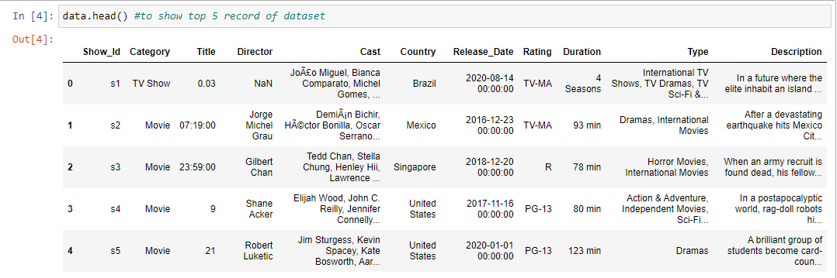
Data Sources & Description:
This Netflix dataset has information about the TV show and movies available on Netflix till 2021 , It contains 7787 rows and 11 columns

Slide 3
Tools Steps:
Explore the data :
Looking for missing value
Correcting data
Clean data
Filtring

Slide 4
Tools & Alogarethm
Numpy
Pandas
Matplotlib
Plotly
Seaborn

Slide 5
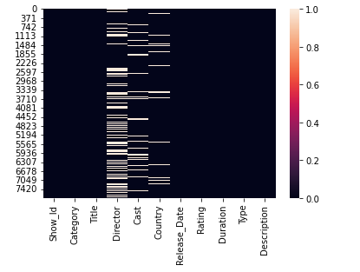
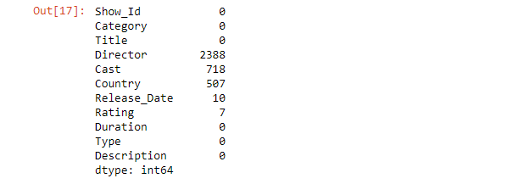
Finding

Slide 6
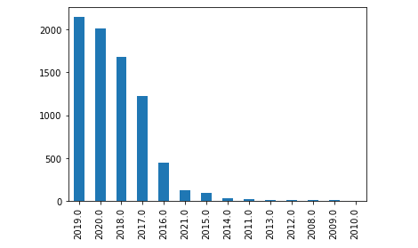
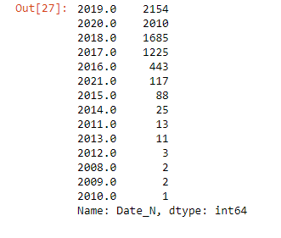
Q. 2) In which year the highest number of the TV Shows & Movies were released.

Slide 7
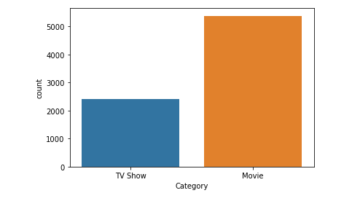

Q. 3) How many Movies & TV Shows are in the dataset

Slide 8
THANKS

